Slide 1


VRAgent: A Model-based Agent for Automated Virtual Reality Scene Exploration and Testing
朱正阳
2025.3.5

Slide 2
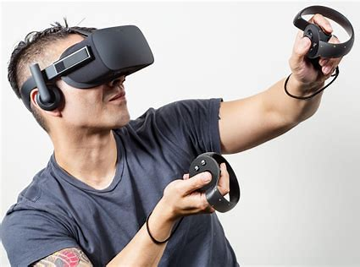
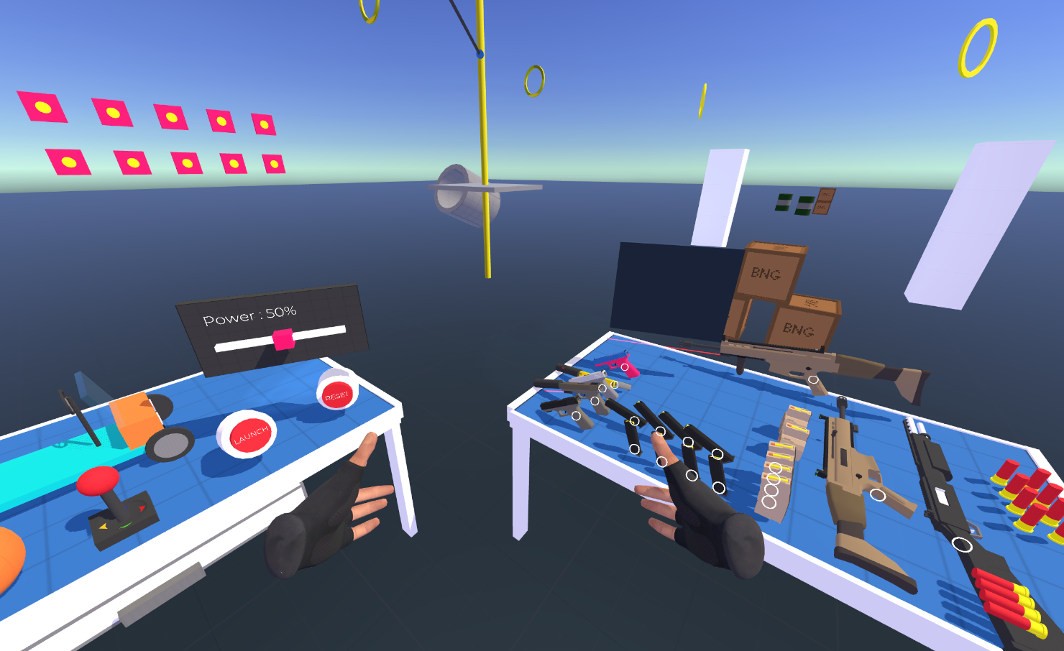
Introduction
Research Background
Virtual Reality(VR) is a computer-based technology that simulates visual, auditory, and tactile effects of an artificially created environment, aiming to immerse the user in a perceived reality.
Most of the VR apps are developed by Unity3D (one of the most popular game engines). Undeniably, there are many bugs during the developing procedure.
Notes:
VR研究背景：许多bug、人工检测困难且费事

Slide 3
Introduction
Research Background
VR apps testing and bug detection is labor-intensive and time-consuming
Automated game testing tool: search-based, model-based, RL based
Due to the sophisticated space and interaction of VR, search-based perform poor
Model-based agent approach is significant and appropriate for VR scene exploration and testing
Notes:
VR研究背景：bug检测工具

Slide 4
Introduction
Motivation
SOTA tools:
exhibit limited performance in scene exploration
can not access complicated task sequences
no scalability: unable to provide a general VR tool to detect different types of VR apps
unsensible to heuristic functional bugs(e.g. Scene Vulnerabilities)
Notes:
场景探索能力差、没有通用性问题、无法解决线性和非线性任务、无法发现潜在问题

Slide 5
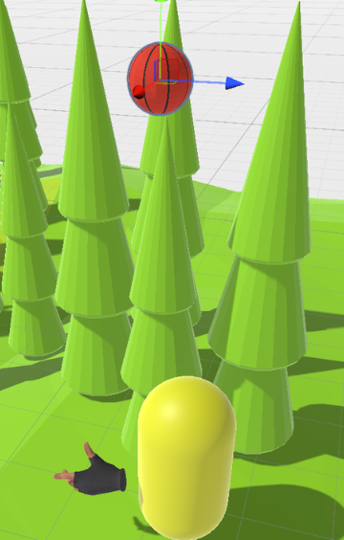
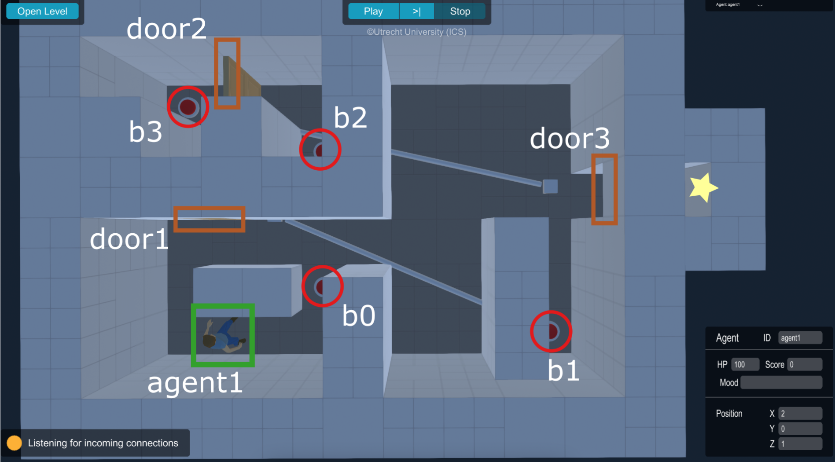
Introduction
Motivation
Fig. complicated task sequences
Fig. Scene Vulnerability
Notes:
两个例子，一个是复杂的场景交互，一个是潜在问题

Slide 6
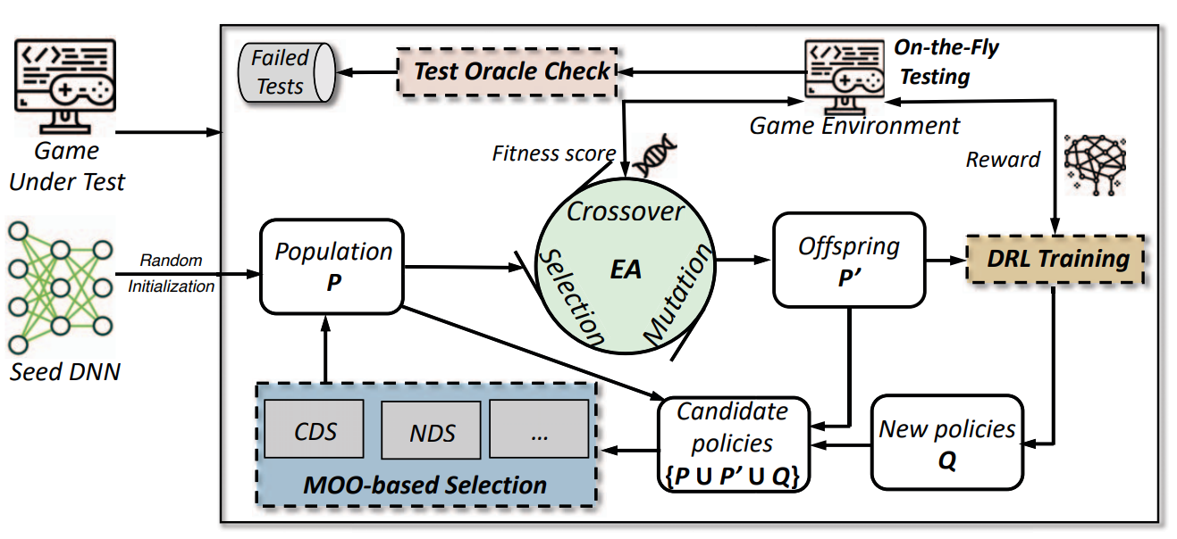
Existing Work 1
(ASE 19)Wuji
Only for specific types of games
Focus on game skills and player movement, without scene exploration
Fig. Wuji
Notes:
Wuji，是能用于动作游戏，且只能触发释放技能，没有场景探索能力 是基于演化强化学习的

Slide 7
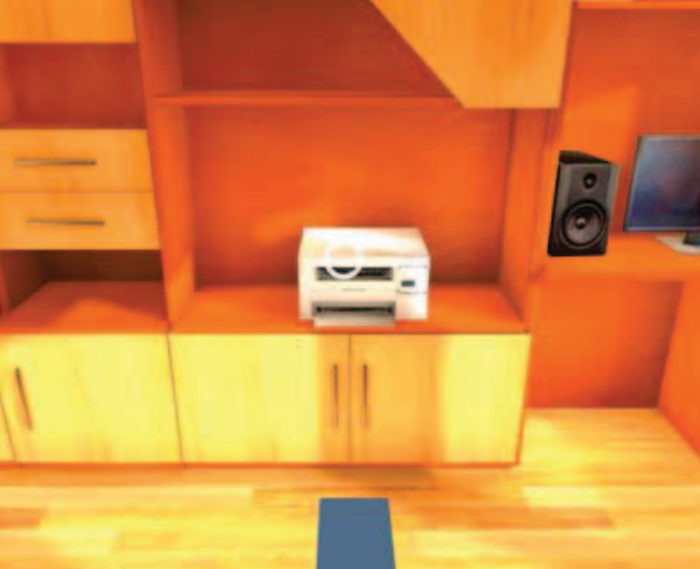
Existing Work 2
(ASE 23)VRGuide
Only can click
Poor performance in accessing complicated VR interaction
Poor performance in accessing combinations of tasks
Data collection set is small and not leading-edge
Fig. VRGuide
Notes:
VRGuide，重点在于寻路优化，但是只能点击，没有复杂VR交互能力，数据集太陈旧且数量少

Slide 8
Workflow
Problem Target
Design a smart enough agent that can simulate a real player to explore the scene, interact with as many as possible entities, and trigger method codes to detect underlying bugs.
Improve evaluation metrics: Interactable Objects Coverage & Method Coverage(MC)
Notes:
目标是设计一个足够聪明的智能体，从而能够提高这些指标

Slide 9
Workflow
Contribution and Novelty
Construction of an open-source VR data set & bug empirical study & general VR task pre-defined
Model-based EAT (Entity, Action, Task) framework for better scalability and ability to process sophisticated interaction
Evaluation and case study to detect real-world bug

Slide 10

Workflow
Overview
Construct a Unity open-source VR project data set;
Result: 971 GitHub repos; After manifest validation and manual check, 104 quality repos
Bug characteristics analysis, root cause analysis, and general VR task pre-defined
Fig. press button(move and trigger action)

Slide 11
Workflow
Data Collection
Construct a Unity open-source VR project data set;
Result: 971 GitHub repos; After manifest validation and manual check, 104 quality repos
Bug characteristics analysis, root cause analysis, and general VR task pre-defined
Fig. press button(move and trigger action)

Slide 12
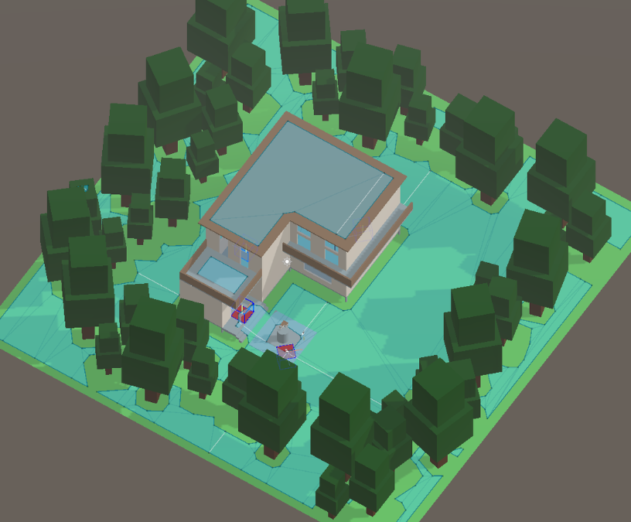
Workflow
Scene Exploration
Navigation Module: Pre-Baked NavMesh + NavmeshAgent;
Shortest Hamiltonian Path Problem: Algorithms based on (1). Greedy, (2).Backtracking-branch and bound pruning, (3). State Compression Dynamic Programming for optimizing global pathfinding problems;
Fig. a scene with pre-baked NavMesh

Slide 13
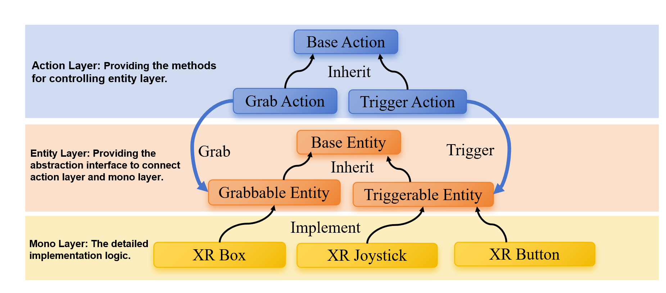
Workflow
Entity-Action-Task Framework
Base Entity interface for abstracting different VR MonoBehaviour Class
Base Action class for abstracting indivisible action of VRAgent
Task Generator for generating List<BaseAction> result of the input BaseEntity[];

Slide 14




Workflow
Entity-Action-Task Framework
Task Generator
Task Instance
List<BaseAction> GetTask(BaseEntity[] e);
Grab-And-Shoot-Gun Task
Input
Output
Parallel Action
Instance
Move Action
Grab Action
$${Entity}_{1}$$
$${Action }_{1}$$
Move Action
Move Action
…
Generate
…
Trigger Action
Trigger Action
Trigger Action
$${Entity}_{m}$$
$${Action }_{n}$$
Asynchronous Action
Code Description
private List<BaseAction> GrabAndShootGunTask(
IGrabbableEntity grabbableEntity, ITriggerableEntity triggerableEntity){
List<BaseAction> task = new List<BaseAction>(){
new MoveAction(_navMeshAgent, moveSpeed, grabbableEntity.transform.position),
new GrabAction(leftHandController, grabbableEntity, new List<BaseAction>(){
new ParallelAction(new List<BaseAction>(){
new MoveAction(_navMeshAgent, moveSpeed, GetRandomTwitchTarget(transform.position)),
new TriggerAction(0.5f, triggerableEntity)
})
})
};
return task;
}

Slide 15
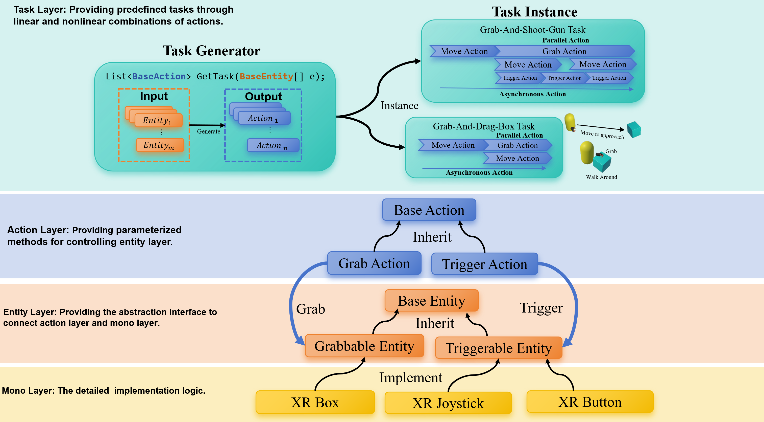
Workflow
Entity-Action-Task Model

Slide 16
Workflow
Agent-Based
basic FSM
Reinforcement Learning Approach
Optimize Policy: PPO、SAC、TD3、DDPG;
Evaluation & Case Study
Experiment: Backtracking to versions before specific bugs are fixed in the git repository commit history;
Metrics: State Coverage(SC), Interactable Objects Coverage (IOC), Method Coverage(MC) and Physical Interaction Coverage (PIC) ;

Slide 17
THANKS

